Slide 1
Lecture 8
Don’t delay: make sure you have a working Verilog environment ASAP
Additional Resources
  Class Web Site (Resources): Line to on-line tutorial
  Class Web Site (Textbook): Palnitkar textbook

Slide 2
Hardware Description Languages (HDLs)

Slide 3
Hardware Description Languages (HDLs)
Benefits
  Complete, unambiguous specification of design
    Inputs, outputs, behavior, timing
  Simulation for design debug
  Synthesis for physical realization of design
Several widely used
  ABEL – primarily for PLDs
  VHDL (VHSIC Hardware Description Language)
  Verilog (1995, 2001)
Numerous tools and vendors
  Capture, edit, simulate, synthesize…

Slide 4
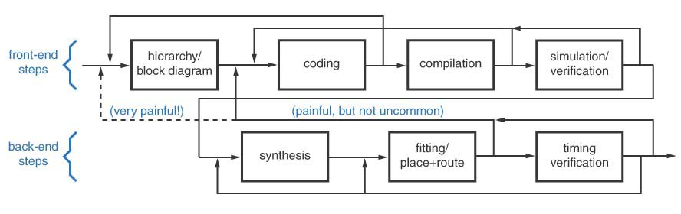
Design Flow

Slide 5
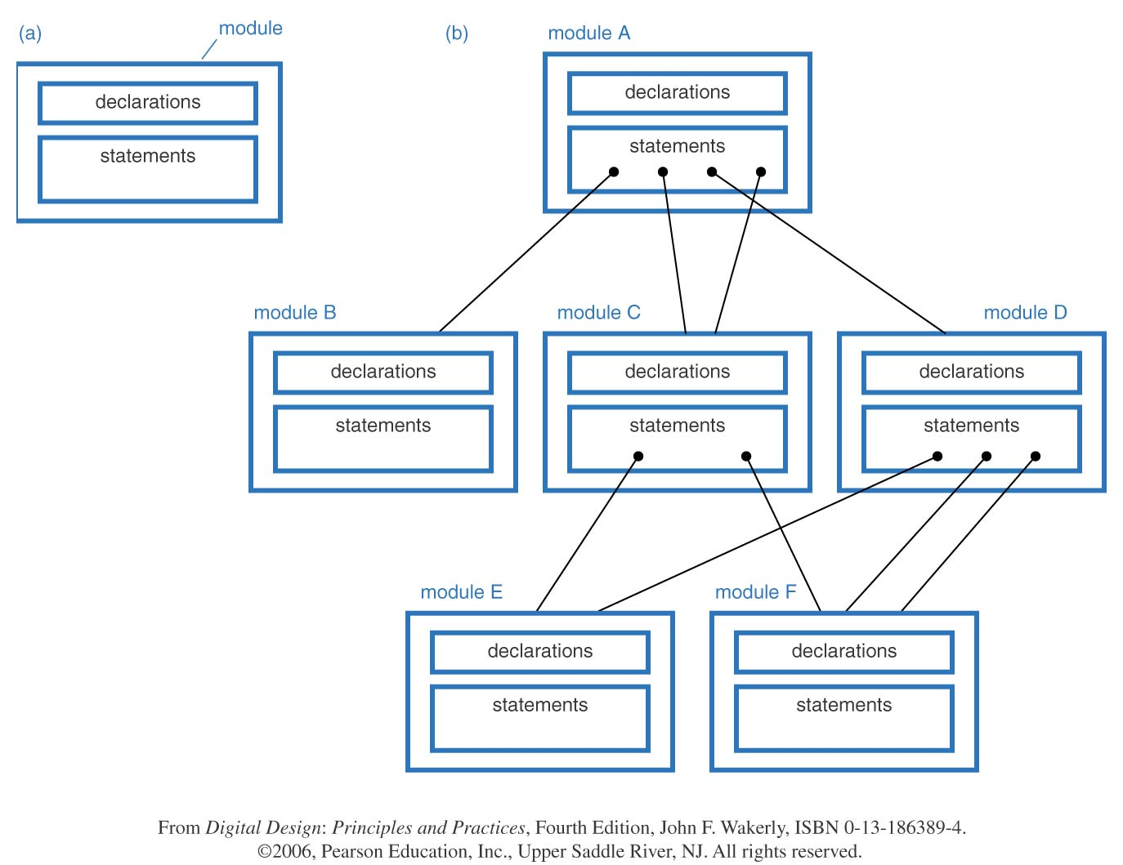
Modules
Different types of module descriptions
  Structural – actual gates
  Behavioral – behavior, no structure
  Dataflow – simple output ← F(inputs)
  Combination of above

Slide 6
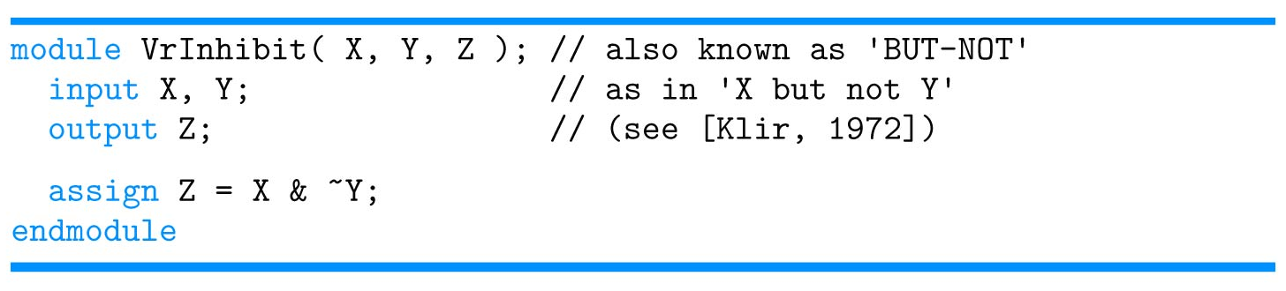
Verilog Syntax
Case sensitive
  “module”, “Module”, “MODULE” not same
  Reserved words are lower case (e.g. “module”)
  User-defined identifiers (e.g. variables, modules, ports) no requirements
    Useful convention: use mixed case, leading capitals
    “BufferFull” not “bufferfull” or “BUFFERFULL”
White space (e.g. spaces, line breaks ) generally ignored
  Use it to make your modules readable
Comments
  // single line comments
  /*
  multiple line
  comments
  */
This is dataflow type of description

Slide 7
Verilog Syntax
Identifiers
  Begin with letter or underscore
  Contain letters, digits, underscores, $
4 Valued Logic
  0, 1, X, Z
Literals (in language sense)
  n’Bddd…d
    n = (decimal) number of bits
    B = radix
      b = binary
      o = octal
      h = hexadecimal
      d = decimal
    ddd…d = digits in designated radix
Number of bits
radix
hexadecimal
R = 4’b1010;
R = 4’hA;
R = 4’o12;
R = 4’d10;
R = 10;
octal

Slide 8
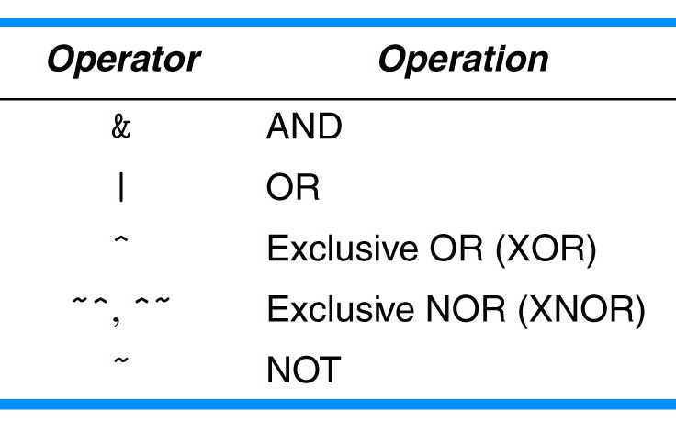
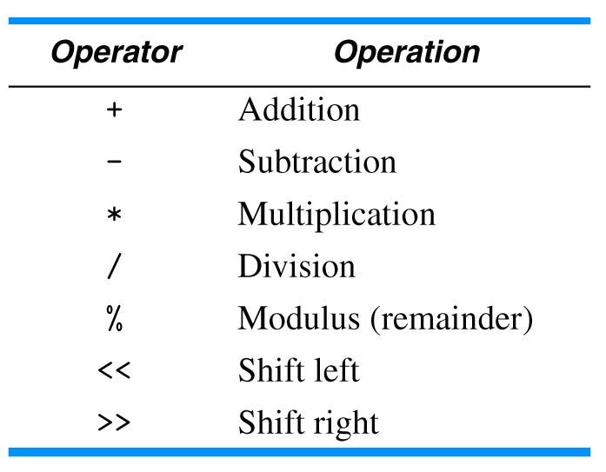
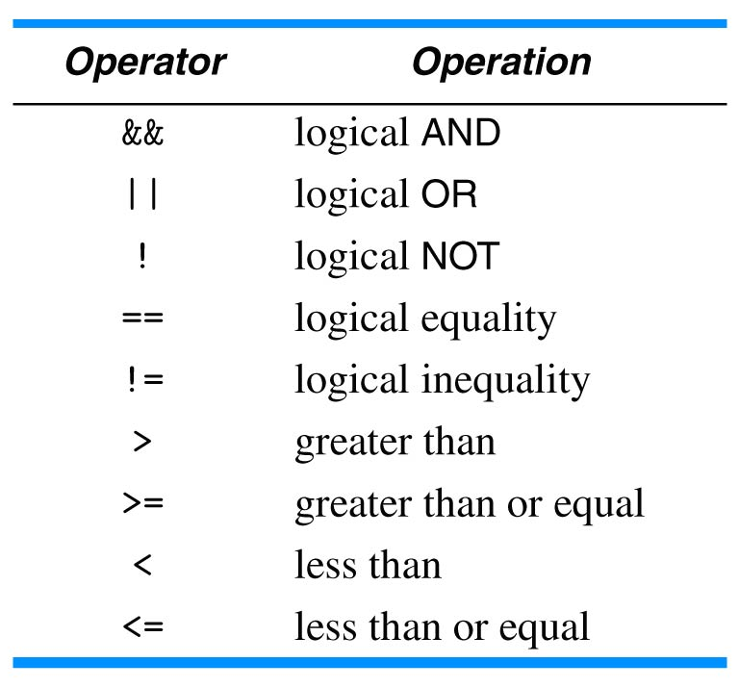
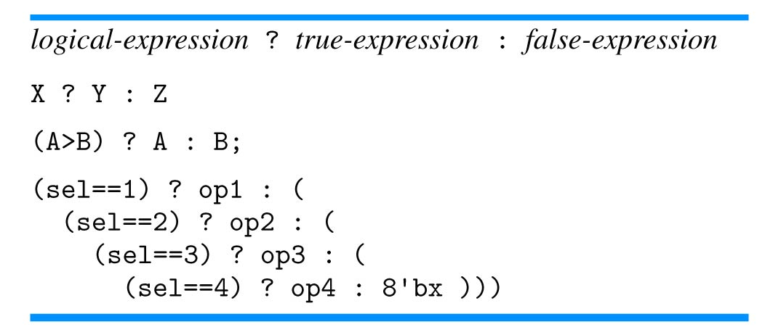
Operators in Verilog
Operators
  Bit-wise Boolean
  Arithmetic and shift
  Logical
  Misc: concatenation, replication

Slide 9
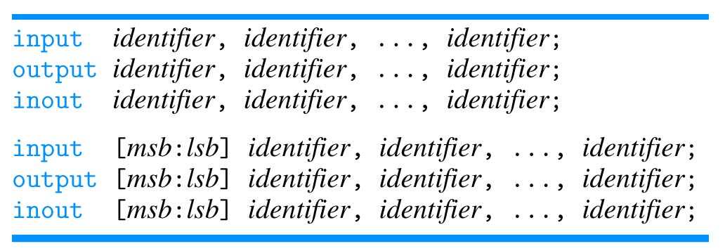

Vectors in Verilog
Vectors
  Signals or ports with width
  Bit select
    Zbus[5]
  Part select
    word1[15:8]

Slide 10
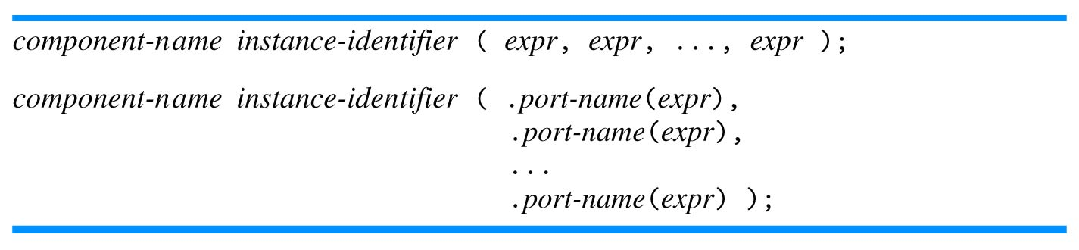
Verilog Instantiation and parameter lists
Instantiating a module
  component name
  instance identifier
Two forms of parameter lists
  By order of declaration
  By explicit port name

Slide 11
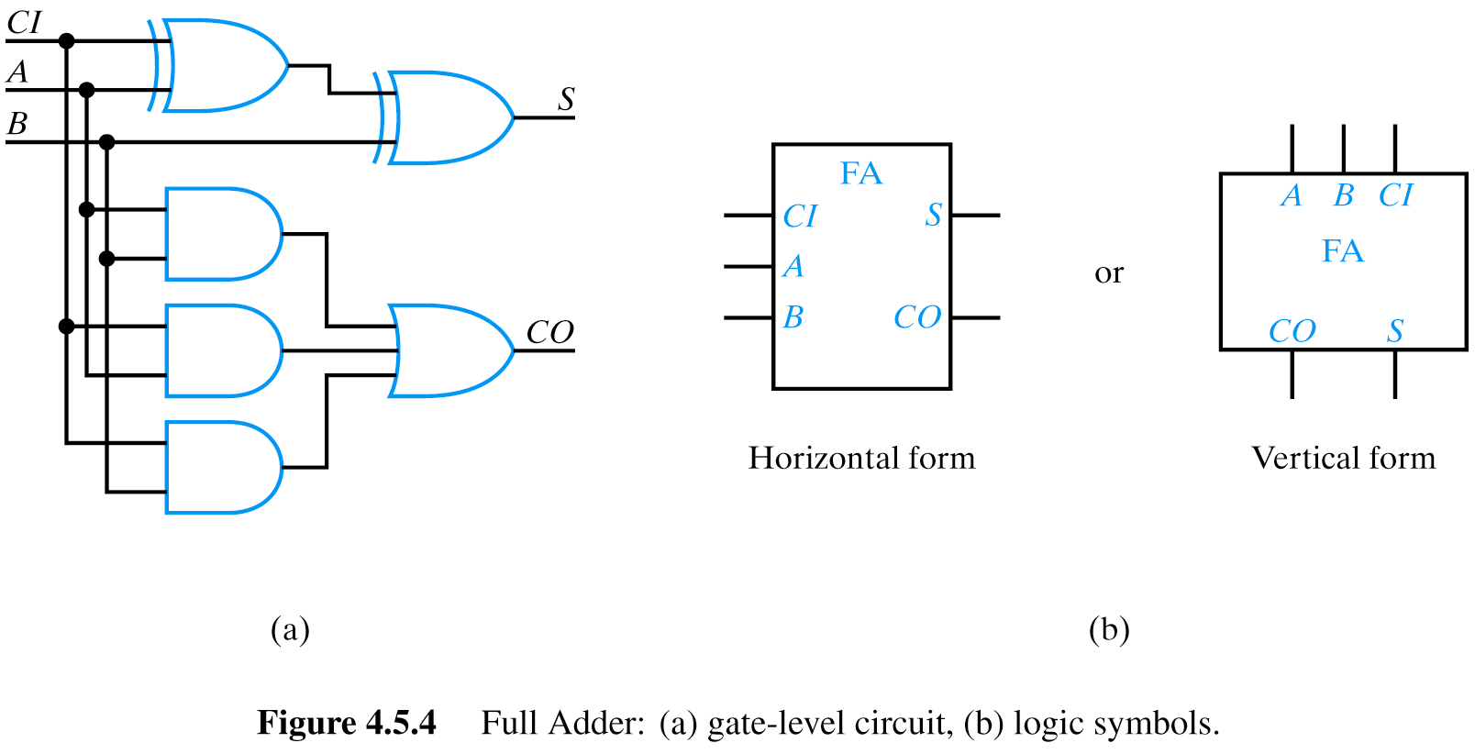

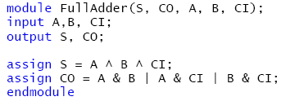

Verilog Dataflow Example: Full Adder
CI A B CO S
0 0 0 0 0
0 0 1 0 1
0 1 0 0 1
0 1 1 1 0
1 0 0 0 1
1 0 1 1 0
1 1 0 1 0
1 1 1 1 1

Slide 12
Verilog Structural Example: Full Adder

Slide 13
Verilog Structural Example: Full Adder

Slide 14
A TestBench
Testbench provides stimulus to module being tested
Testbench must obey interface and protocol
  Interface: signal direction and width (e.g. bus)
  Protocol: timing and edge relationships
Testbench facilitates response from module
  TestBench can be written to independently verify response
  Human can examine waveforms produced in simulation
  TestBench can be written to format response (e.g. table) for later examination or processing
Testbench is a Verilog module!

Slide 15
A TestBench
Module
0
1
1
0
1
0
0
0
1
0
0
0
TestBench
TestBench instantiates module and provides necessary inputs, called test vectors
Declares registers (“reg”) which will be connected to the module input ports
Declares wires which will be connected to the module output ports

Slide 16
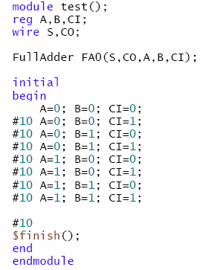
Testbench Example for previously presented Full Adder

Slide 17
A Complete Example Using Dataflow Style

Slide 18
A Complete Example Using Dataflow Style
Design a circuit that takes as input a binary representation of a month, and an additional Boolean input LeapYear (LY) which is 1 if the current year is a leap year, and determines the number of days in the month.
The circuit should have four outputs: D28, D29, D30, D31 which are true when the given month has exactly the indicated number of days.
For example, if the month inputs indicate March, the output D31 will be 1 while D30, D29 and D28 will be 0.
Use the fewest number of bits to encode the month input.

Slide 19
A Complete Example Using Dataflow Style
Methodology (will vary with target implementation!)
  Draw a “black box”, label inputs and outputs (I/Os)
  Confirm formats, representations, timing of I/Os
  Create a truth table
  Use K-maps to obtain minimized/reduced equations
  Translate equations to Verilog dataflow style syntax
  Create a testbench to appropriately test the module
      Appropriate may mean exhaustive testing
  Compile and test
  Debug : Exam your results; if not as expected, work backwards
  Bask in your success

Slide 20
Black Box and Truthtable
DaysInMonth
M
4
D31
D30
LY
D29
D28
Use of X (don’t care) in inputs reduces rows in truth table and helps to clarify functionality
Use of X in outputs may lead to simpler Boolean equations
Perhaps ask question about encoding used…

Slide 21
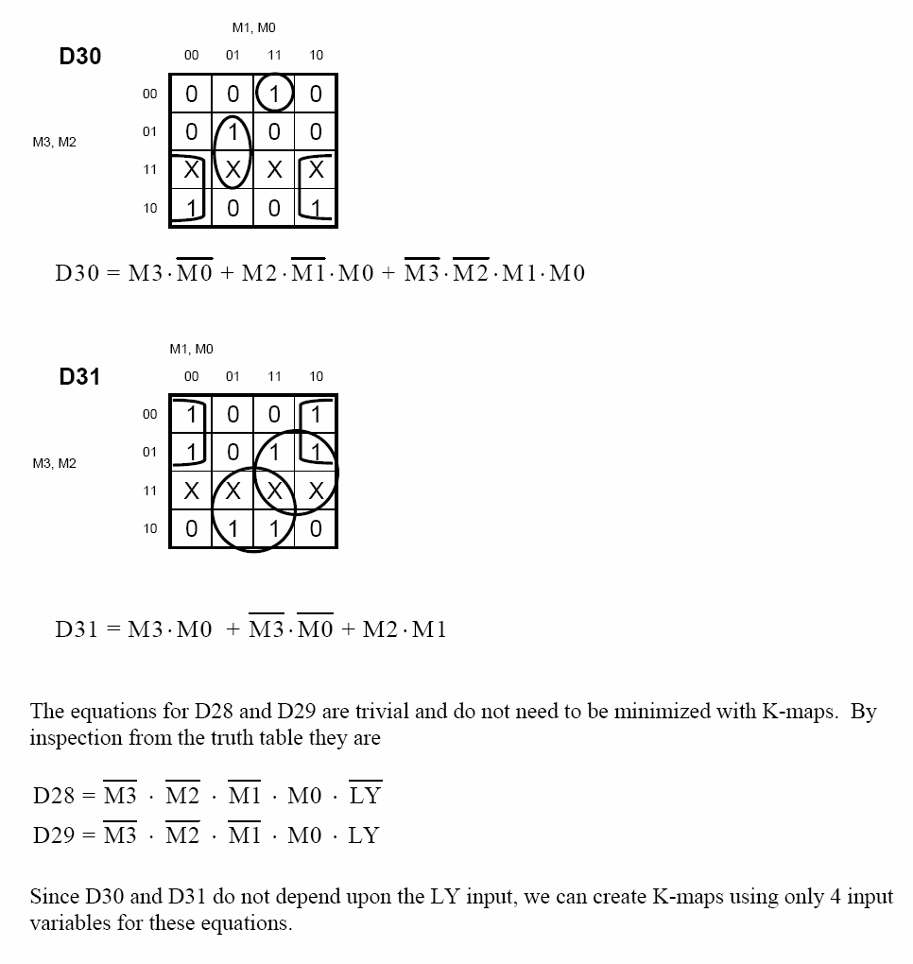
K-Maps and Reduced Equations

Slide 22
Verilog Dataflow Style Module
module DaysInMonth(M3,M2,M1,M0,LY,D28,D29,D30,D31);
input M3,M2,M1,M0; // encoded value of month
// Jan = 0000, Feb = 0001, etc
input LY; // 1 if leap year
output D28; // 1 if month has 28 days
output D29; // 1 if month has 29 days
output D30; // 1 if month has 30 days
output D31; // 1 if month has 31 days
assign #6 D28 = ~M3 & ~M2 & ~M1 & M0 & ~LY;
assign #6 D29 = ~M3 & ~M2 & ~M1 & M0 & LY;
assign #6 D30 = M3 & ~M0
| M2 & ~M1 & M0
| ~M3 & ~M2 & M1 & M0;
assign #6 D31 = M3 & M0
| ~M3 & ~M0
| M2 & M1;
endmodule
Usually a block comment here with description of module, author, date, other pertinent information
DaysInMonth
M
4
D31
D30
LY
D29
D28
Delay

Slide 23
Verilog Testbench

Slide 24
Verilog Testbench for the same example
module TestDays();
reg M3,M2,M1,M0;
reg LY;
wire D28, D29, D30, D31;
DaysInMonth D1 (M3,M2,M1,M0,LY,D28,D29,D30,D31);
initial
begin
#10 LY = 1'bx;
M3 = 1'b0; M2 = 1'b0; M1 = 1'b0; M0 = 1'b0; // Jan
#10 M3 = 1'b0; M2 = 1'b0; M1 = 1'b0; M0 = 1'b1; // Feb
LY = 1'b0; // Not Leap Year
#10 LY = 1'b1; // Leap Year
#10 LY = 1'bx;
M3 = 1'b0; M2 = 1'b0; M1 = 1'b1; M0 = 1'b0; // Mar
#10 M3 = 1'b0; M2 = 1'b0; M1 = 1'b1; M0 = 1'b1; // Apr
#10 M3 = 1'b0; M2 = 1'b1; M1 = 1'b0; M0 = 1'b0; // May
#10 M3 = 1'b0; M2 = 1'b1; M1 = 1'b0; M0 = 1'b1; // Jun
#10 M3 = 1'b0; M2 = 1'b1; M1 = 1'b1; M0 = 1'b0; // Jul
#10 M3 = 1'b0; M2 = 1'b1; M1 = 1'b1; M0 = 1'b1; // Aug
#10 M3 = 1'b1; M2 = 1'b0; M1 = 1'b0; M0 = 1'b0; // Sep
#10 M3 = 1'b1; M2 = 1'b0; M1 = 1'b0; M0 = 1'b1; // Oct
#10 M3 = 1'b1; M2 = 1'b0; M1 = 1'b1; M0 = 1'b0; // Nov
#10 M3 = 1'b1; M2 = 1'b0; M1 = 1'b1; M0 = 1'b1; // Dec
#20 $finish();
end
endmodule
Use of don’t care inputs
Ability to easily determine all input values
for any test vector
module DaysInMonth(M3,M2,M1,M0,LY,D28,D29,D30,D31);
input M3,M2,M1,M0; // encoded value of month
// Jan = 0000, Feb = 0001 …
input LY; // 1 if leap year
output D28; // 1 if month has 28 days
output D29; // 1 if month has 29 days
output D30; // 1 if month has 30 days
output D31; // 1 if month has 31 days
assign #6 D28 = ~M3 & ~M2 & ~M1 & M0 & ~LY;
assign #6 D29 = ~M3 & ~M2 & ~M1 & M0 & LY;
assign #6 D30 = M3 & ~M0
| M2 & ~M1 & M0
| ~M3 & ~M2 & M1 & M0;
assign #6 D31 = M3 & M0
| ~M3 & ~M0
| M2 & M1;
endmodule

Slide 25
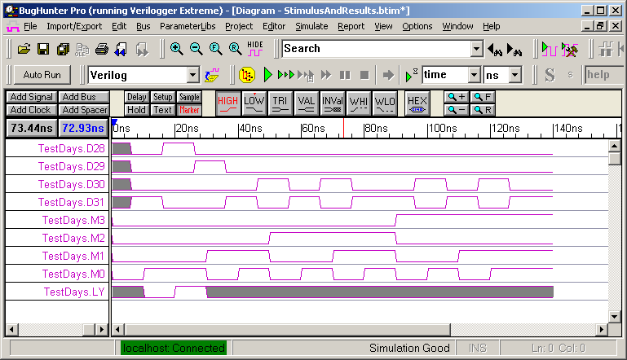
The Timing Diagram
Note how easy to read, determine if all input combinations used

Slide 26
A Better Solution: Buses (Vectors)
module DaysInMonth(M,LY,D28,D29,D30,D31);
input [3:0] M; // encoded value of month
// Jan = 0000, Feb = 0001, etc
input LY; // 1 if leap year
output D28; // 1 if month has 28 days
output D29; // 1 if month has 29 days
output D30; // 1 if month has 30 days
output D31; // 1 if month has 31 days
assign #6 D28 = ~M[3] & ~M[2] & ~M[1] & M[0] & ~LY;
assign #6 D29 = ~M[3] & ~M[2] & ~M[1] & M[0] & LY;
assign #6 D30 = M[3] & ~M[0]
| M[2] & ~M[1] & M[0]
| ~M[3] & ~M[2] & M[1] & M[0];
assign #6 D31 = M[3] & M[0]
| ~M[3] & ~M[0]
| M[2] & M[1];
endmodule
DaysInMonth
M
4
D31
D30
LY
D29
D28

Slide 27
A Better Solution: Buses (Vectors)
Port types must match
module TestDays();
reg [3:0] M;
reg LY;
wire D28,D29,D30,D31;
DaysInMonth D1 (M,LY,D28,D29,D30,D31);
initial
begin
#10 LY= 1'bx;
M= 4’b0000; // Jan
#10 M= 4’b0001; // Feb
LY= 0;
#10 LY= 1;
#10 LY= 1'bx;
M= 4’b0010; // Mar
#10 M= 4’b0011; // Apr
#10 M= 4’b0100; // May
#10 M= 4’b0101; // Jun
#10 M= 4’b0110; // Jul
#10 M= 4’b0111; // Aug
#10 M= 4’b1000; // Sep
#10 M= 4’b1001; // Oct
#10 M= 4’b1010; // Nov
#10 M= 4’b1011; // Dec
#20 $finish();
end
endmodule
module DaysInMonth(M,LY,D28,D29,D30,D31);
input [3:0] M; // encoded value of month
// Jan = 0000, Feb = 0001, etc
input LY; // 1 if leap year
output D28; // 1 if month has 28 days
output D29; // 1 if month has 29 days
output D30; // 1 if month has 30 days
output D31; // 1 if month has 31 days
assign #6 D28 = ~M[3] & ~M[2] & ~M[1] & M[0] & ~LY;
assign #6 D29 = ~M[3] & ~M[2] & ~M[1] & M[0] & LY;
assign #6 D30 = M[3] & ~M[0]
| M[2] & ~M[1] & M[0]
| ~M[3] & ~M[2] & M[1] & M[0];
assign #6 D31 = M[3] & M[0]
| ~M[3] & ~M[0]
| M[2] & M[1];
endmodule

Slide 28
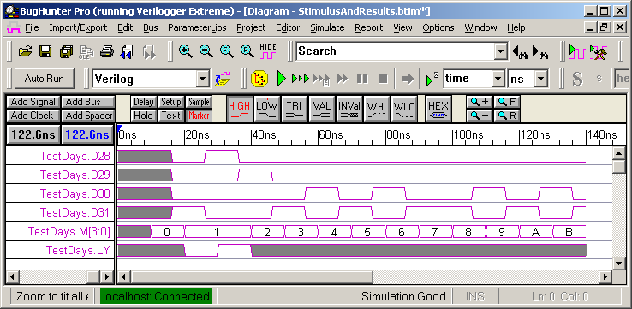
TestBenches with Buses
Buses “bundled” together in waveform display improve readability

Slide 29
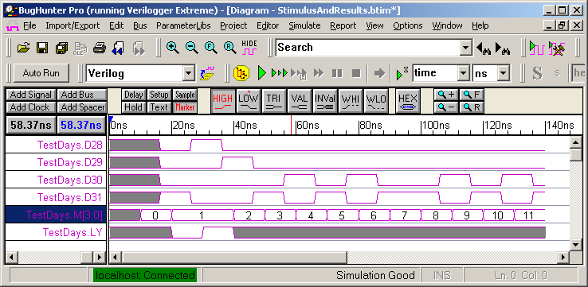
Alternative TestBenches with Buses
module TestDays();
reg [3:0] M;
reg LY;
wire D28, D29, D30, D31;
DaysInMonth D1 (M,LY,D28,D29,D30,D31);
initial
begin
#10 LY= 1'bx;
M= 0; // Jan
#10 M= 1; // Feb
LY= 0;
#10 LY= 1;
#10 LY= 1'bx;
M= 2; // Mar
#10 M= 3; // Apr
#10 M= 4; // May
#10 M= 5; // Jun
#10 M= 6; // Jul
#10 M= 7; // Aug
#10 M= 8; // Sep
#10 M= 9; // Oct
#10 M= 10; // Nov
#10 M= 11; // Dec
#20 $finish();
end
endmodule
Most tools provide a means to change display radix

Slide 30
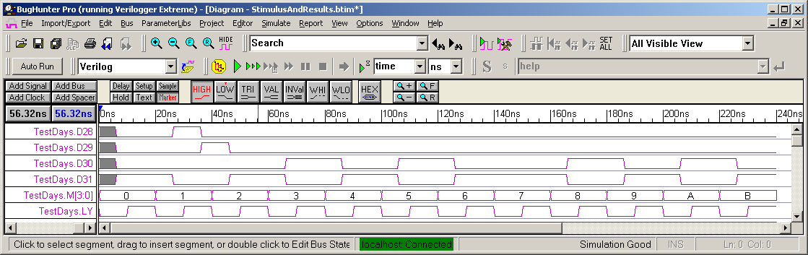
TestBenches with Behavioral Code
module TestDays();
reg [3:0]M;
reg LY;
wire D28, D29, D30, D31;
DaysInMonth D1 (M, LY, D28, D29, D30, D31);
initial
begin
for (M = 0; M <= 11; M=M+1)
begin
LY = 0; #10;
LY = 1; #10;
end
$finish();
end
endmodule
Behavioral code to facilitate creation of test vectors
Behavioral code for automating checking
e.g. consider a method to verify a multiplier design

Slide 31
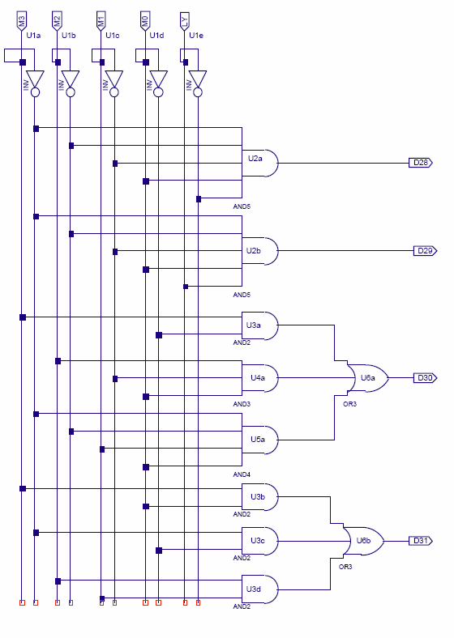

Slide 32
Verilog Structural Style Module
module DaysInMonth(M,LY,D28,D29,D30,D31);
input [3:0]M; // encoded value of month
// Jan = 0000, Feb = 0001, etc
input LY; // 1 if leap year
output D28; // 1 if month has 28 days
output D29; // 1 if month has 29 days
output D30; // 1 if month has 30 days
output D31; // 1 if month has 31 days
wire T1,T2,T3,T4,T5,T6;
wire M3bar,M2bar,M1bar,M0bar,Lybar;
not #(3,3)
U1a(M3bar,M[3]),
U1b(M2bar,M[2]),
U1c(M1bar,M[1]),
U1d(M0bar,M[0]),
U1e(LYbar,LY);
and #(5,4)
U2a(D28,M3bar,M2bar,M1bar,M[0],LYbar),
U2b(D29,M3bar,M2bar,M1bar,M[0],LY);
and #(5,4)
U3a(T1,M[3],M0bar),
U4a(T2,M[2],M1bar,M[0]),
U5a(T3,M3bar,M2bar,M[1],M[0]);
or #(5,5)
U6a(D30,T1,T2,T3);
and #(5,4)
U3b(T4,M[3],M[0]),
U3c(T5,M3bar,M0bar),
U3d(T6,M[2],M[1]);
or #(5,5)
U6b(D31,T4,T5,T6);
endmodule
Reflects actual implementation.
Primitives: or, and, nand, xor, xnor, nor, not
Variable number of inputs
Output is first port
Wires used to connect gate outputs/inputs
Comma separated list will share t_{pd}
Can have asymmetric delays (t_{PLH} t_{PHL})
Note: can use same testbench used with dataflow (maybe need to accommodate different Tpd)

Slide 33
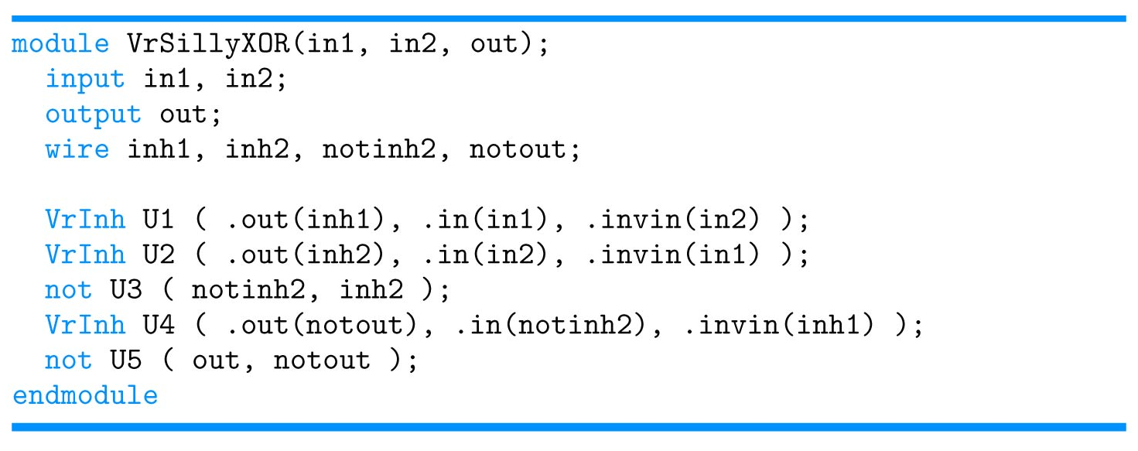
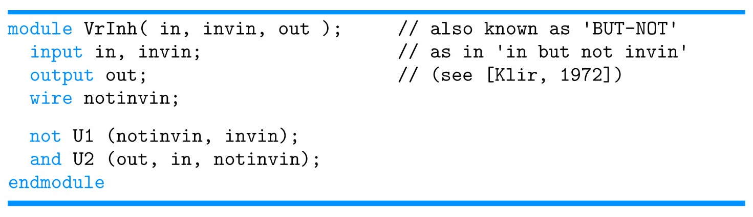
Hierarchical Structural Description
Note that this is structural and hierarchical

Slide 34
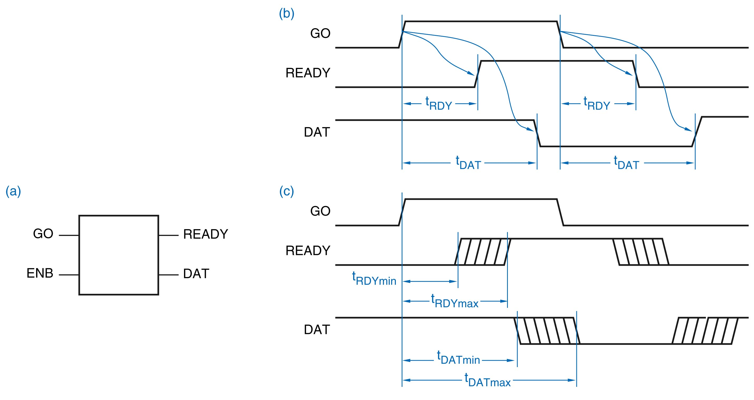
Timing Diagrams

Slide 35
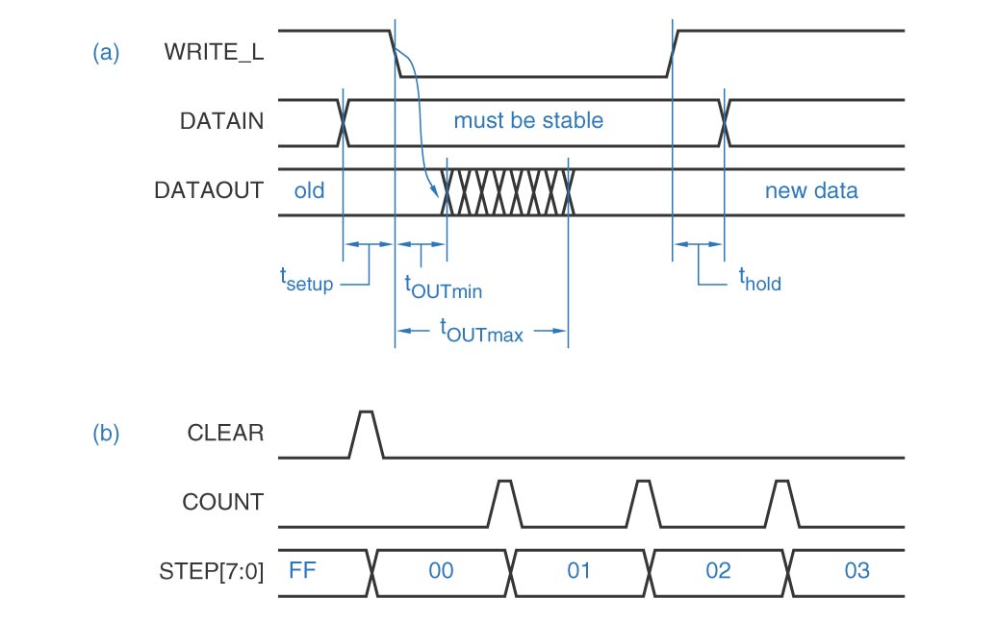
Timing Diagrams

Slide 36
Sources
Prof. Mark G. Faust
John Wakerly

